Slide 1
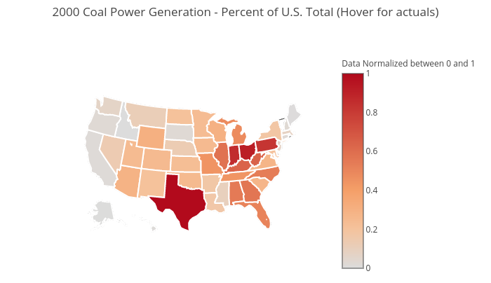
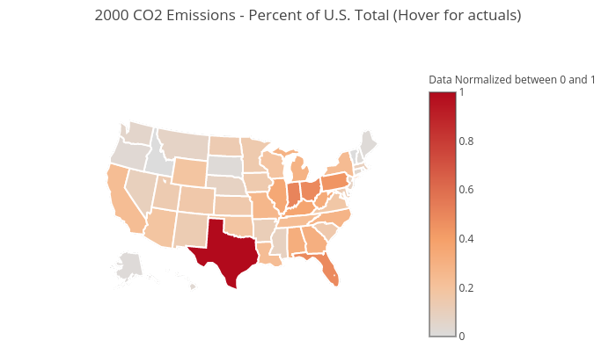
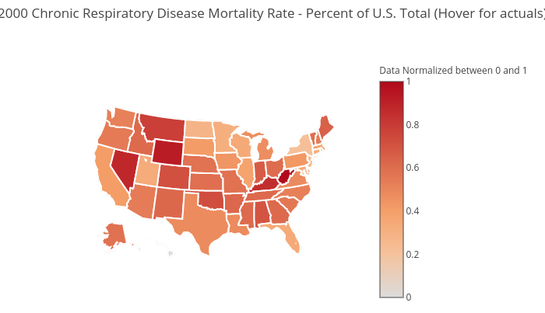
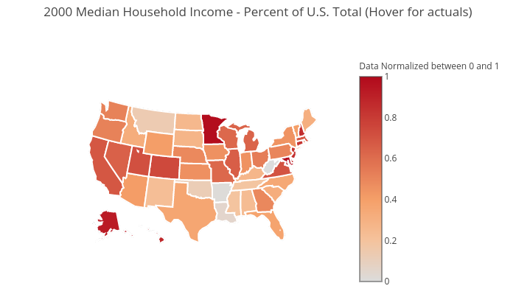
Click map to view actuals

Slide 2
Coal Power Generation vs CO2 Emissions Year 2000
Coal Power Generation
CO2 Emissions
Click map to view actuals

Slide 3
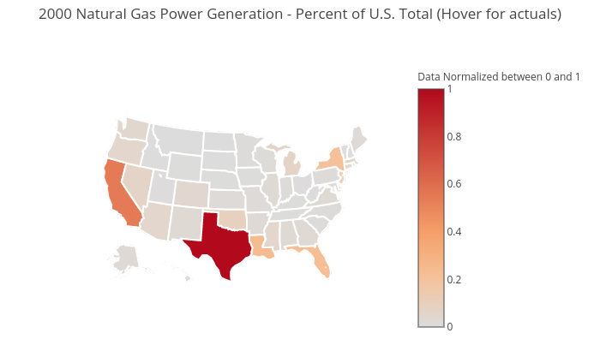
Natural Gas Power Generation vs CO2 Emissions Year 2000
Natural Gas Power Generation
CO2 Emissions
Click map to view actuals

Slide 4
Chronic Respiratory Disease Mortality Rate vs CO2 Emissions Year 2000
Chronic Respiratory Disease Mortality Rate
CO2 Emissions
Click map to view actuals

Slide 5
Chronic Respiratory Disease Mortality Rate vs Median Household Income Year 2000
Chronic Respiratory Disease Mortality Rate
Median Household Income
Click map to view actuals

Slide 6
Coal Power Generation vs Median Household Income Year 2000
Coal Power Generation
Median Household Income
Click map to view actuals

Slide 7
Natural Gas Power Generation vs Median Household Income Year 2000
Natural Gas Power Generation
Median Household Income
Click map to view actuals

Slide 8
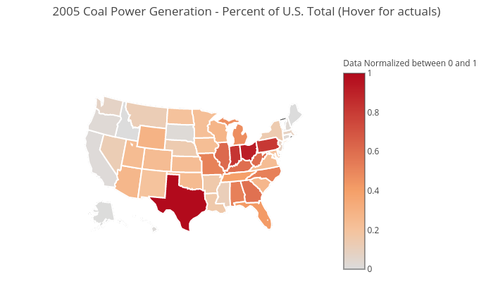
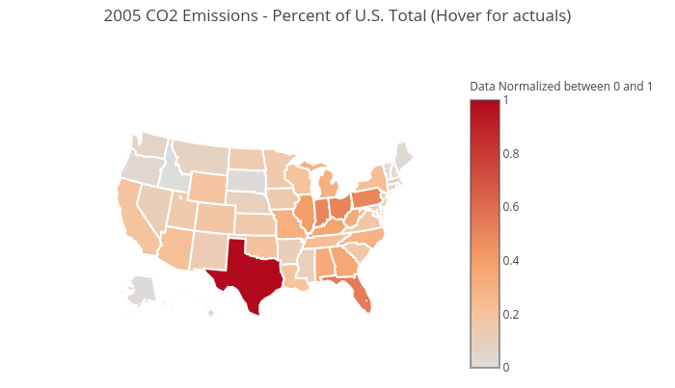

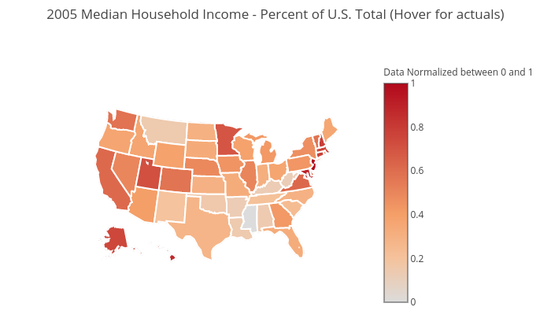
Click map to view actuals

Slide 9
Coal Power Generation vs CO2 Emissions Year 2005
Coal Power Generation
CO2 Emissions
Click map to view actuals

Slide 10
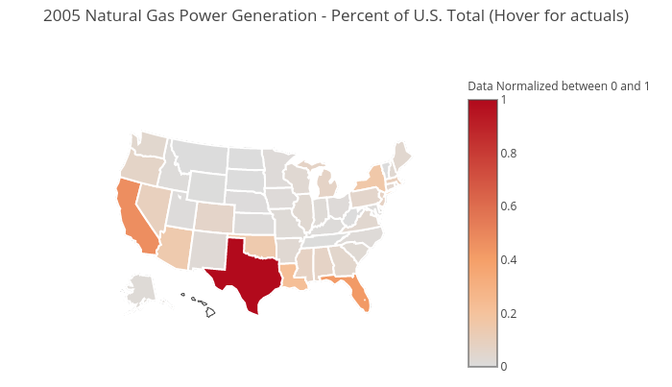
Natural Gas Power Generation vs CO2 Emissions Year 2005
Natural Gas Power Generation
CO2 Emissions
Click map to view actuals

Slide 11
Chronic Respiratory Disease Mortality Rate vs CO2 Emissions Year 2005
Chronic Respiratory Disease Mortality Rate
CO2 Emissions
Click map to view actuals

Slide 12
Chronic Respiratory Disease Mortality Rate vs Median Household Income Year 2005
Chronic Respiratory Disease Mortality Rate
Median Household Income
Click map to view actuals

Slide 13
Coal Power Generation vs Median Household Income Year 2005
Coal Power Generation
Median Household Income
Click map to view actuals

Slide 14
Natural Gas Power Generation vs Median Household Income Year 2005
Natural Gas Power Generation
Median Household Income
Click map to view actuals

Slide 15



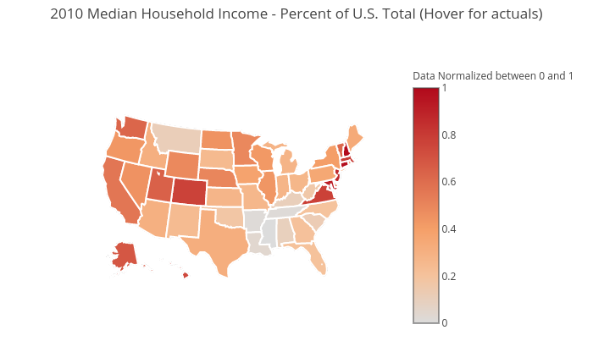
Click map to view actuals

Slide 16
Coal Power Generation vs CO2 Emissions Year 2010
Coal Power Generation
CO2 Emissions
Click map to view actuals

Slide 17
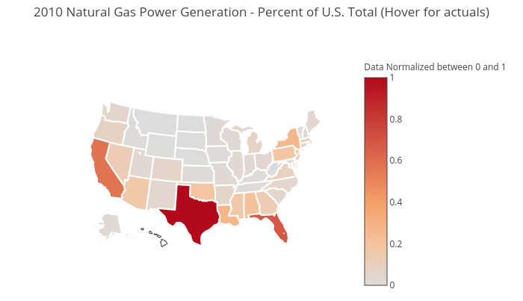
Natural Gas Power Generation vs CO2 Emissions Year 2010
Natural Gas Power Generation
CO2 Emissions
Click map to view actuals

Slide 18
Chronic Respiratory Disease Mortality Rate vs CO2 Emissions Year 2010
Chronic Respiratory Disease Mortality Rate
CO2 Emissions
Click map to view actuals

Slide 19
Chronic Respiratory Disease Mortality Rate vs Median Household Income Year 2010
Chronic Respiratory Disease Mortality Rate
Median Household Income
Click map to view actuals

Slide 20
Coal Power Generation vs Median Household Income Year 2010
Coal Power Generation
Median Household Income
Click map to view actuals

Slide 21
Natural Gas Power Generation vs Median Household Income Year 2010
Natural Gas Power Generation
Median Household Income
Click map to view actuals

Slide 22
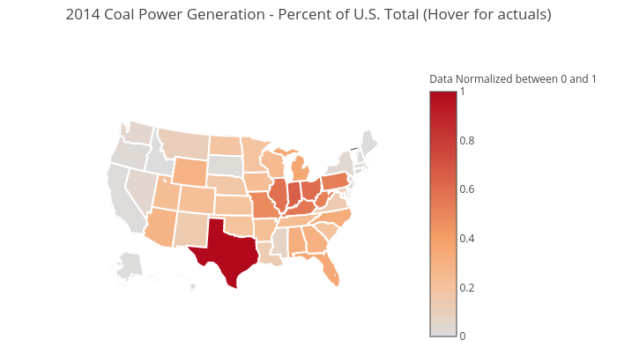

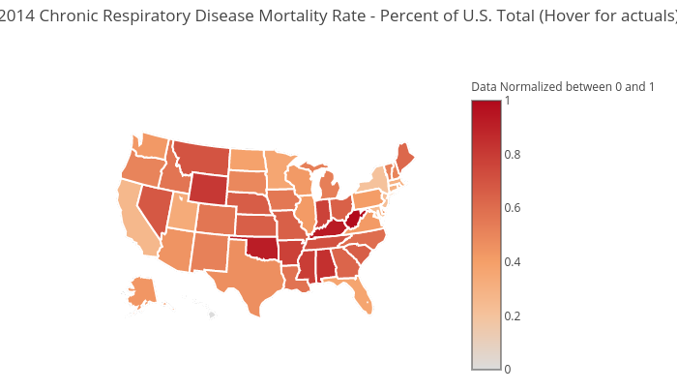
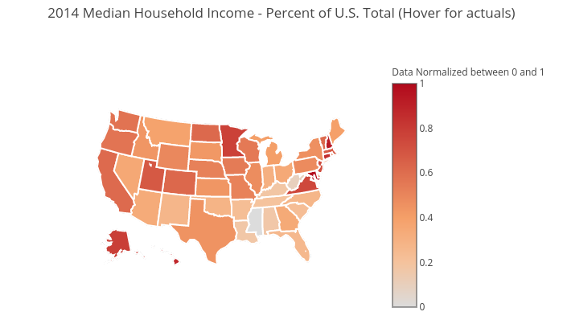
Click map to view actuals

Slide 23
Coal Power Generation vs CO2 Emissions Year 2014
Coal Power Generation
CO2 Emissions
Click map to view actuals

Slide 24
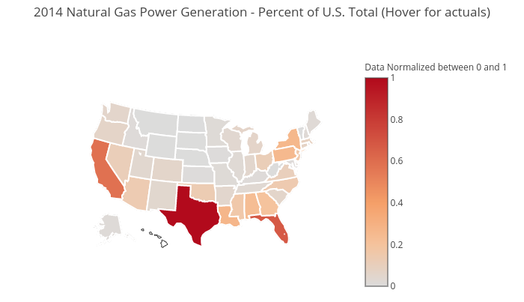
Natural Gas Power Generation vs CO2 Emissions Year 2014
Natural Gas Power Generation
CO2 Emissions
Click map to view actuals

Slide 25
Chronic Respiratory Disease Mortality Rate vs CO2 Emissions Year 2014
Chronic Respiratory Disease Mortality Rate
CO2 Emissions
Click map to view actuals

Slide 26
Chronic Respiratory Disease Mortality Rate vs Median Household Income Year 2014
Chronic Respiratory Disease Mortality Rate
Median Household Income
Click map to view actuals

Slide 27
Coal Power Generation vs Median Household Income Year 2014
Coal Power Generation
Median Household Income
Click map to view actuals

Slide 28
Natural Gas Power Generation vs Median Household Income Year 2014
Natural Gas Power Generation
Median Household Income
Click map to view actuals

Slide 29
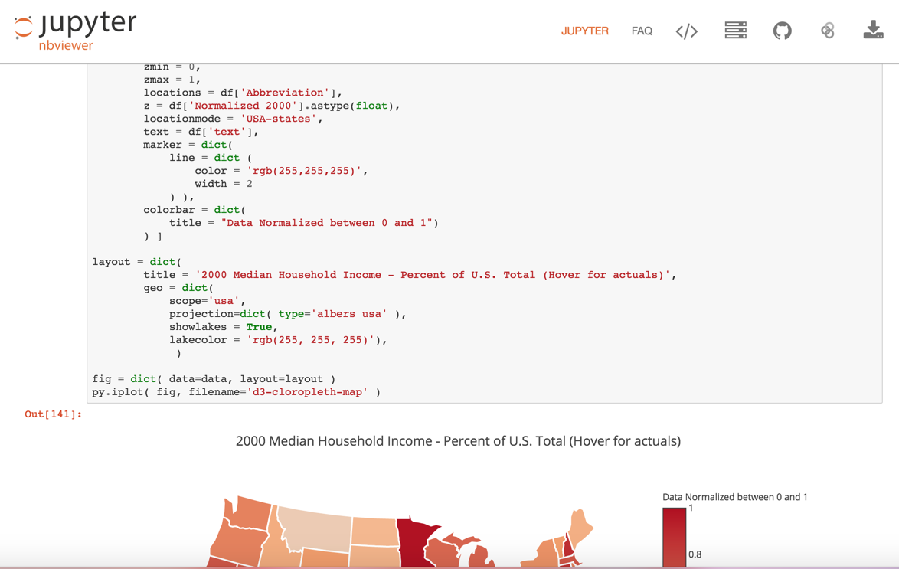
View Jupyter Notebook

